Slide 1
16s rRNA gene analysis with QIIME2
Laboratory of Computational & Synthetic Biology, Korea University
Junshik Bae

Slide 2
Contents
What is QIIME?
Terminology
Materials for QIIME2 protocol
Method

Slide 3
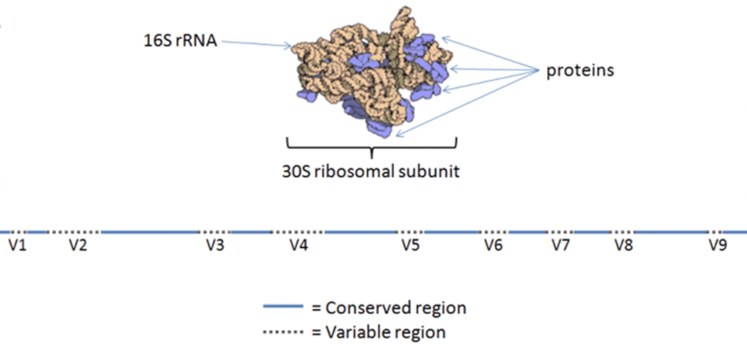
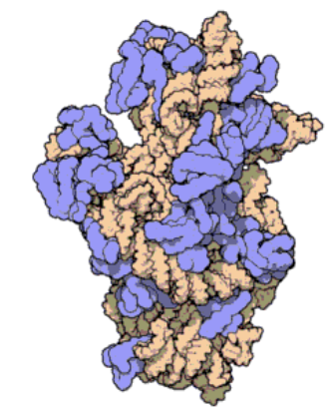
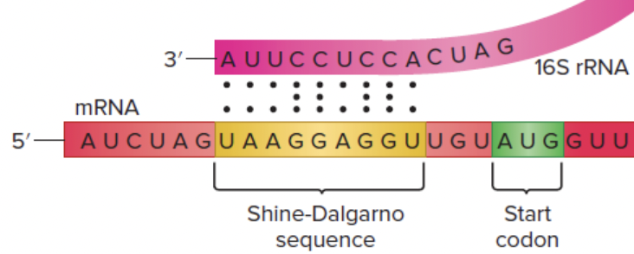
16s rRNA?
16s ribosomal RNA
Central structure component of the 30S subunit of a prokaryotic ribosome
Required for the initiation of protein synthesis
Stabilization of correct codon-anticodon pairing in the A site of the ribosome during mRNA translation
Why used?
Due to its functional constancy and highly conserved nature
->Highly conserved primer binding site (Universal primer)
Ex) Most common primer pair / 27F-1492R(Weisberg et al. 1991)
It has been an important phylogenetic marker
Molecular structure of the 30S Subunit from Thermus thermophilus.
Proteins are shown in blue and the single RNA strand in orange. (Schluenzen F, Cell(2000))
Wikipeidia
Notes:
16S rRNA는 16S ribosomal RNA의 줄임말로, 원핵생물 리보솜의 30S 소단위체를 구성하고 있는 RNA이다
즉, 16S rRNA를 코딩하는 유전자를 16S rRNA gene이라고 일컫는다.
Carl Woese and George E. Fox were two of the people who pioneered the use of 16S rRNA in phylogenetics in 1977주요
주요 기능?
Gene이 mRNA로 transcription이 되고, mRNA가 리보솜에서 protein으로 translation되는 과정에서, 리보솜의 30S subunit이 mRNA의 샤인-달가노 서열(Shine-Dalgarno sequence)을 인식하고 리보솜에 정확하게 결합할 수 있도록 도와주는 역할을 하고 있다
Stabilizes correct codon-anticodon pairing in the A-site by forming a hydrogen bond
The A-site (A for aminoacyl) of a ribosome is a binding site for charged t-RNA molecules during protein synthesis
응용 방법?
16SrRNA gene의 서열을 비교하여 원핵생물을 동정할 수 있다. 이 서열은 대부분 상당히 보존되어 있는 한편 일부 구간에서는 높은 염기서열 다양성이 나타난다. 특히 동종간에는 다양성이 거의 없는 반면에 타종간에는 다양성이 나타나므로 생물동정에 사용된다.

Slide 4
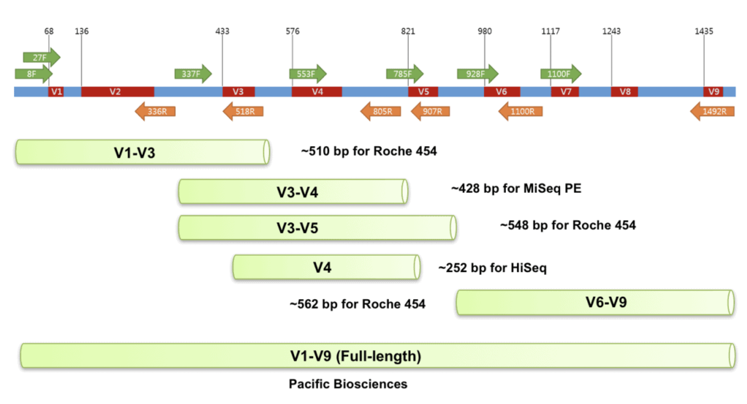
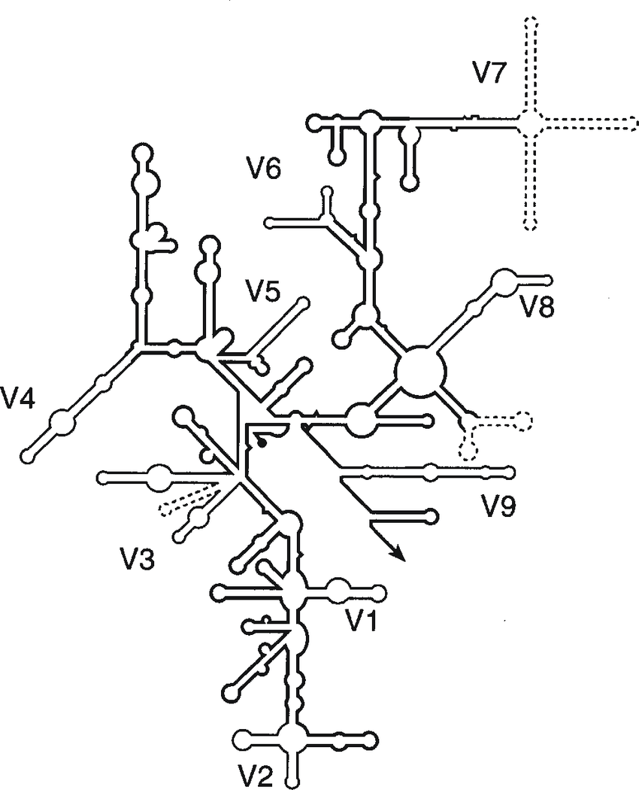
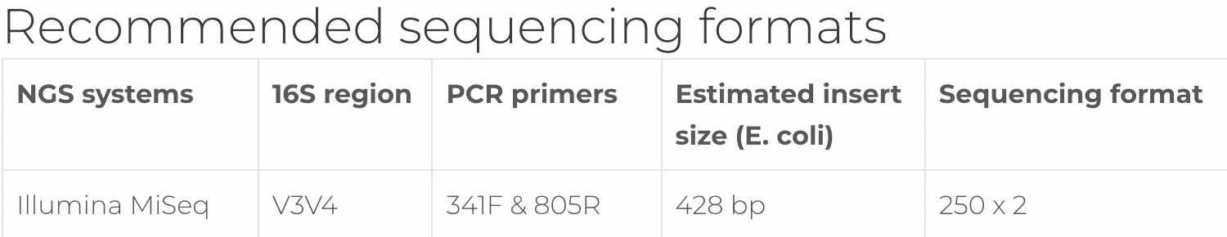
16s rRNA?
Contains 9 hypervariable regions (V1–V9)
ranging from about 30 to 100 base pairs long
highly conserved sequences between hypervariable regions
Some difficulties…
powerful tool for bacterial taxonomic studies…
But it struggles to differentiate between closely related species.
Ex) Enterobacteriaceae, Clostridiaceae, and Peptostreptococcaceae,
species can share up to 99% sequence similarity across the full 16S gene.
As a result, the V4 sequences can differ by only a few nucleotides,
leaving reference databases unable to reliably classify at lower taxonomic levels.
ezbiocloud.net
G.Tannok. Current Issues Molec. Bio(1999)
Notes:
초가변영역? V1-V9까지 나눠져 있고, 30-100 bp 구간.
V1-v9 사이의 각 구간(파란색) – highly conserved sequence
실질적인 동정과 서열 비교가 가능한 구간은 V1부터 V9에 해당하는 부분들, molecular chronometer라고도 표현. Molecular chronometer는 개체간의 진화적인 거리를 확인할 수 있는 분자 물질
한계점?
Bacteria species 동정에 분명 매우 효율적인 방법이나, 아주 근접한 종들 간에는 정확한 구분이 어렵다는 단점이 있다.
예를 들면..저런 종들.
전체 16s 구간을 놓고 보면, 99% 상동성을 보이는 종들도 있기 때문에-단적인 예로, v4 region sequence는 몇개의 base 차이만을 보이기도 한다(근연종간)
시퀀싱 플랫폼, 시퀀서간 타겟으로 하는 16s 구간도 차이가 있다. 로슈같은 경우는 ~ 일루미나 마이싴은 V3-V4. 팩바이오는 전체를 다 커버가능

Slide 5
QIIME2?
Quantitative Insights Into Microbial Ecology
Powerful, Extensible, and Decentralized microbiome analysis package with analysis transparency
Starting with raw DNA sequence data
Finish with publication-quality figures and statistical results
Can also track the data provenance -> Can see how I got there
->Set of commands to transform microbiome data into intermediate outputs and visualizations
Notes:
카임/차임?
미생물생태-미생물군집분석을 겨냥한 tool. A-Z까지. Raw data로 시작해서 paper-publish가 가능한 수준의 figure와 통계자료를 가시화해서 보여주는.
편리한 기능
그리고 중간중간 데이터가 변환되고 가공되는, 즉 분석의 전반적인 과정을 쭉 tracking 할 수 있기 때문에, 결과물에 대한 신뢰도와, error check가 지속적으로 가능하다.
간단 요약, Set of commands to transform microbiome data into intermediate outputs and visualizations

Slide 6
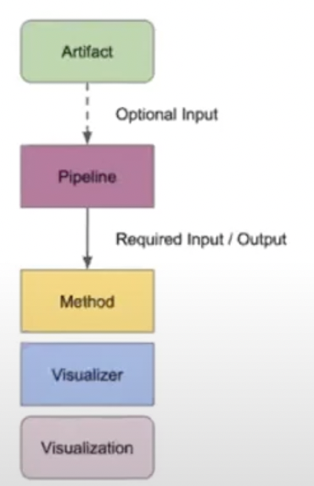
Major terms
Artifact
Artifacts are intermediate data in QIIME2 analysis.
-> It is generated by QIIME 2 and consumed by QIIME 2 (rather than by a human / Intermediate step).
Artifacts can be generated either by importing data into QIIME 2 or as out from a QIIME 2 action.
Extension used as .qza(QIIME Zipped Artifact). Artifacts can be used as input to QIIME 2 actions,
for use with Python 3 or QIIME2R for use with R.
Visualization
Visualizations are QIIME 2 results that represent terminal output in an analysis(End point)
-> It is generated by QIIME 2 and consumed by human.
Visualizations can be generated by QIIME 2 visualizers or pipelines.
Extension used as .qzv(QIIME Zipped Visualization). Visualizations can be viewed with QIIME2 View / QIIME2
Action
Process responsible / conducted for procducing artifacts / visualizations
Notes:
아티팩트 : 중간값. 차임이라는 프로세스에서 지속적으로 사용되는 데이터들을 아티팩트라고 총칭. 차임이라는 툴이 소비가능한 형태(form), 즉 확장자가 그렇게 되어있는 상태. 차임의 인풋값으로 사용될 수도 있고, 커맨드를 통해 파이썬3, R 등 다른 process에서도 활용 가능
비주얼라이제이션 : 차임2의 결과값. 엔드포인트라고도 설명되는데, 완전 최종은 아니고, 중간중간 생성되는 새로운 아티팩트를 사람이 이해하고 확인하기 쉬운 형태로 변환한(가시화 시킨) 데이터 형태 / 표나 그래프 등. 확장자는 아티팩트와 다름
액션 : 아티팩트와 비주얼라이제이션을 생성하고 가공하는, 차임에서 발생하는 프로세스를 통칭하는 말

Slide 7
Materials for QIIME2
Sequence data
Gene-data set generated from 16s rRNA gene fragment, sequenced from Illumina platform.
(Default parameter/database set for Illumina-derived sequences)
First data type we will meet after sequencing from sequencer(Illumina)
Contains DNA sequences and quality scores for each base
Should be in FASTQ format, follows Illumina naming format.
SampleName_S1_L001_ R2_001.fastq.gz
Name of the sample
Always 001(Fixed format)
Lane number
Indicates the direction of read(R1 : Forward / R2 : reverse)
Sample number on sample sheet
Notes:
기본적으로 시퀀스 데이터 필요. 샘플을 채취하고, 실험을 통해(dnaprep, libraryprep, sequencing)
디폴트값. 가장 먼저 다루게 될, 가공되지 않은 raw data type.
시퀀스와 각 base에 대한 quality score를 포함함.
Sample name-actual name giving to sequence unit
S1-usually an injection order which injected into sequencer 시퀀서에 삽입된 샘플의 실질적인 순서(flow cell?) 여튼간
L001-lane number / which lane the sequence was sequenced

Slide 8
Files Should be demultiplexed -> Every sequence/barcode for each sample / and bringing to same directory
Multiplexing-> a fancy word for mixing a whole bunch of stuff together
How do we know which sample each read came from? Done by appending a unique barcode (index or tag) sequence to one or both ends of each sequence. (Keep it in sample metadata file)
Detecting these barcode sequences and mapping them to the samples they belong allows us to demultiplex sequences.
2 other files contained inside the same directory
1) metadata.yaml
Simple text file that contains only the text {phred-offset: 33} on a single line
2) MANIFEST
Three- column comma-separated text file
Most recent Illumina sequence data is produced with the CASAVA pipeline 1.8+ which uses the PHRED+33 encoding indicated by the “metadata.yml” text
SRR3202913 , SRR3202913_S0_L001_R1_001.fastq.gz , forward
sample-id filename direction
To import a directory of sequence files to QIIME2, directory should contain all 3 elements.
Notes:
디멜티플렉싱. 멀티플렉스가 데이터를 한 티렉토리로 모으

Slide 9
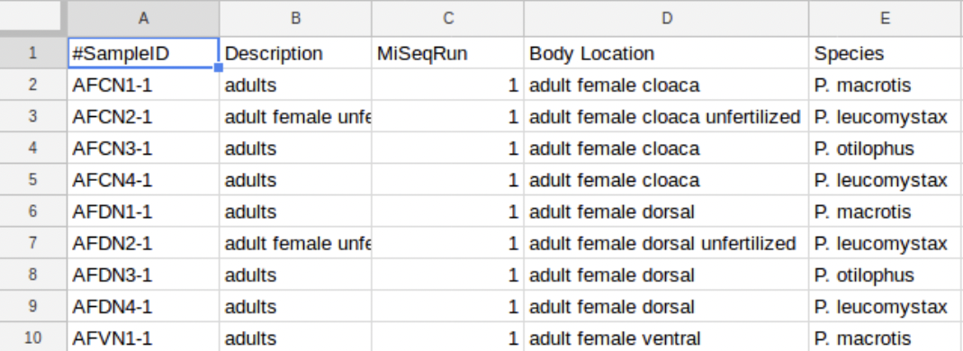
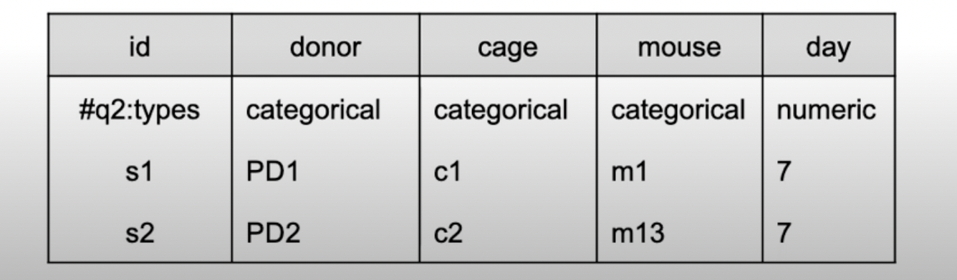
Sample metadata
Factors that may affect the hypothesis
(ex) In case of human microbiome, age, weight..In soil study, pH, salinity..
Where/When they were sampled, where they were sequenced?
Should be stored in Tab-separated text file
(TSV/CSV : text format which store data in a table structure, record in the table is recorded as one line of the text file)
MIxS-Minimun common information for any sequence specifications
Rough example of sample metadata set-YOUTUBE QIIME 2
Can include other more categories needed for further data analysis…Think of it! With your study aim.
KEEMEI-Can use for correct formatting and helps identify any errors in the metadata file

Slide 10
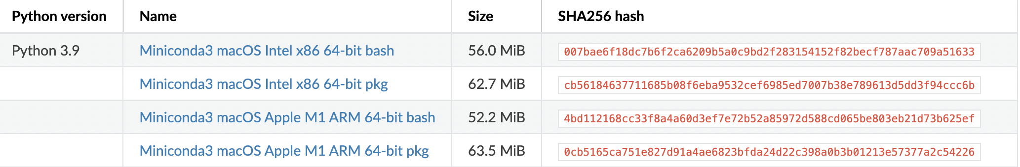
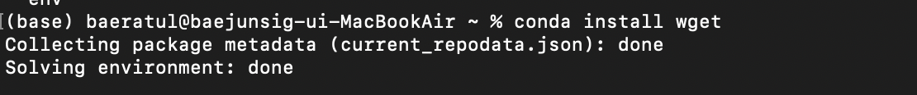
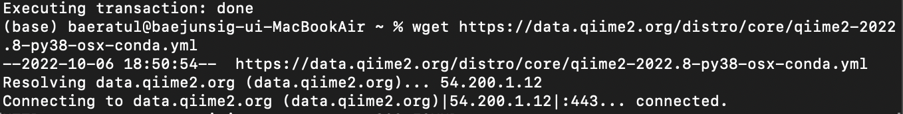
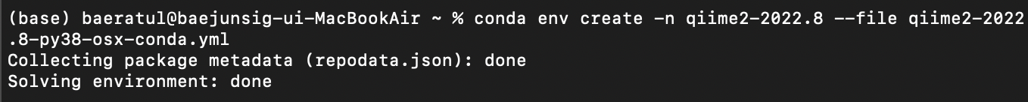
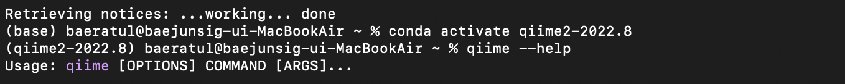
Software
Downloading process has been simplified by ANACONDA/MINICONDA package (entire pkg available)
Download the latest version of python3 -> Get an installer which suites your hardware
-> Import file from wget
Insert wget install code
Import content from wget
Create conda environment
Activation code

Slide 11
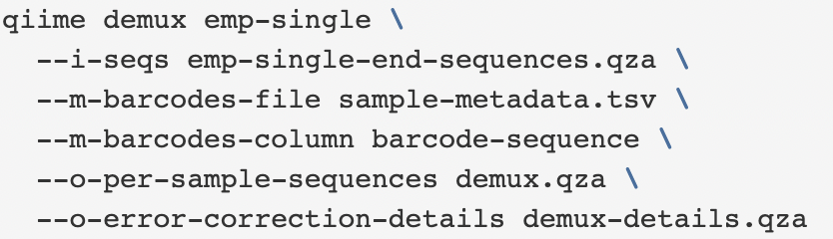
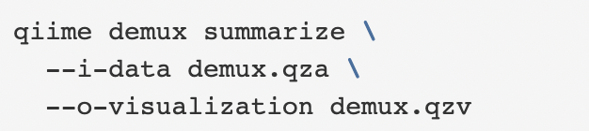
Method
1. Earning raw sequence data(probably FASTQ data, containing DNA sequences and quality scores for each base) by previous experiment.
2. Demultiplex these reads to determine which sample each read came from.
demux-demultuplexing command
Checking sample barcode form metadata information
demux.qza-QIIME 2 artifact will contain the demultiplexed sequences
Golay-error correction details
Generating a summary of the demultiplexing results
Which allows to determine
how many sequences were obtained per sample
distribution of sequence qualities at each position in sequence data
Notes:
error correcting code, (ECC) is used for controlling errors in data over unreliable or noisy communication channels

Slide 12
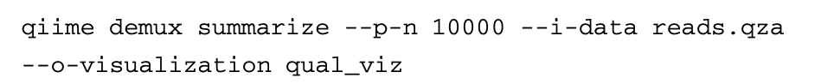
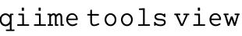
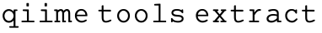
Visualizing sequence quality. In this case, 10000 reads.
The sequence qualities inform the choices for some of the sequence-processing parameters,
Ex) truncation parameters of the DADA2 denoising step
Command launching visualization(launched in web browser)
Data extraction command from .qza or .qzv file

Slide 13
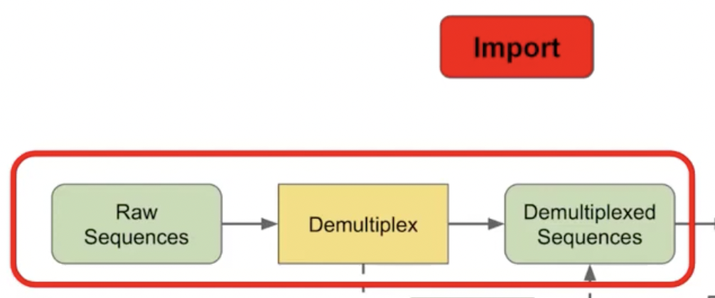
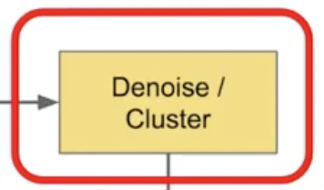
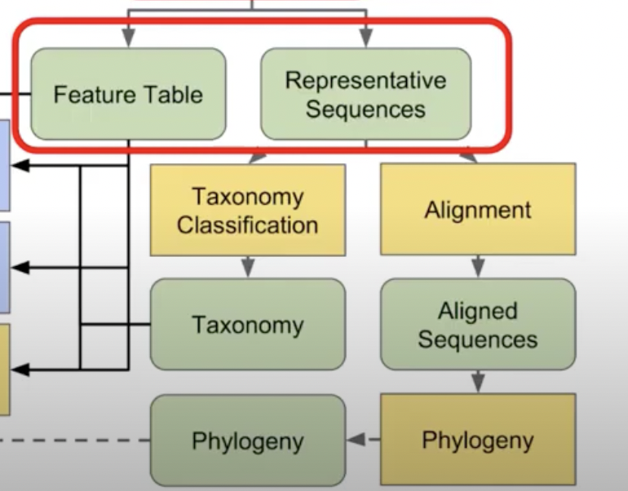
Notes:
처음 workflow부터 살펴보면, 시퀀스를 뽑아내서, 여러 가공과정을 거치고 필요한 format에 맞게 데이터가 파일로 변환되었는지 계속 tracking 해주고,
디멀티플렉싱 거쳐서 시퀀스

Slide 14
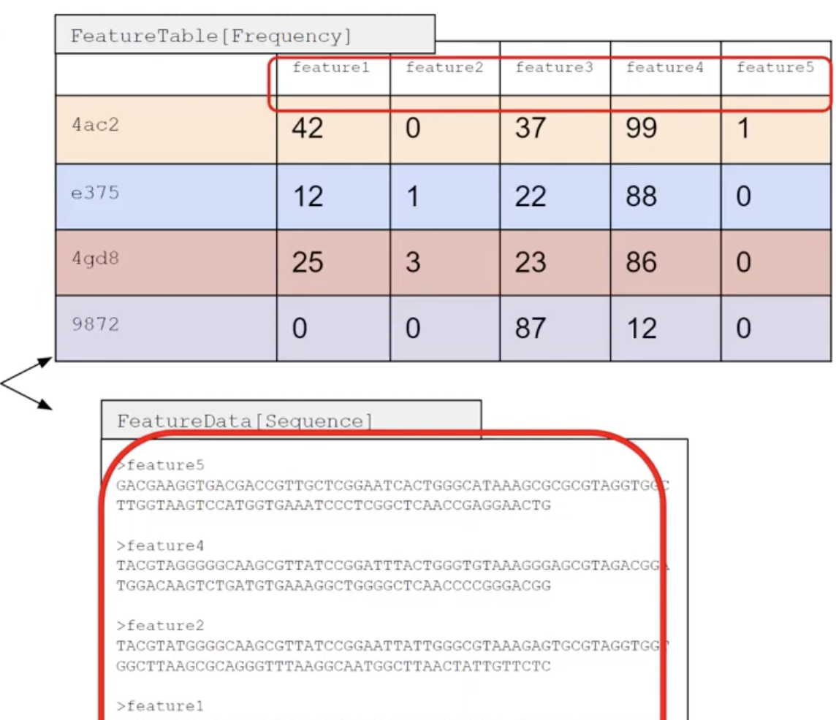
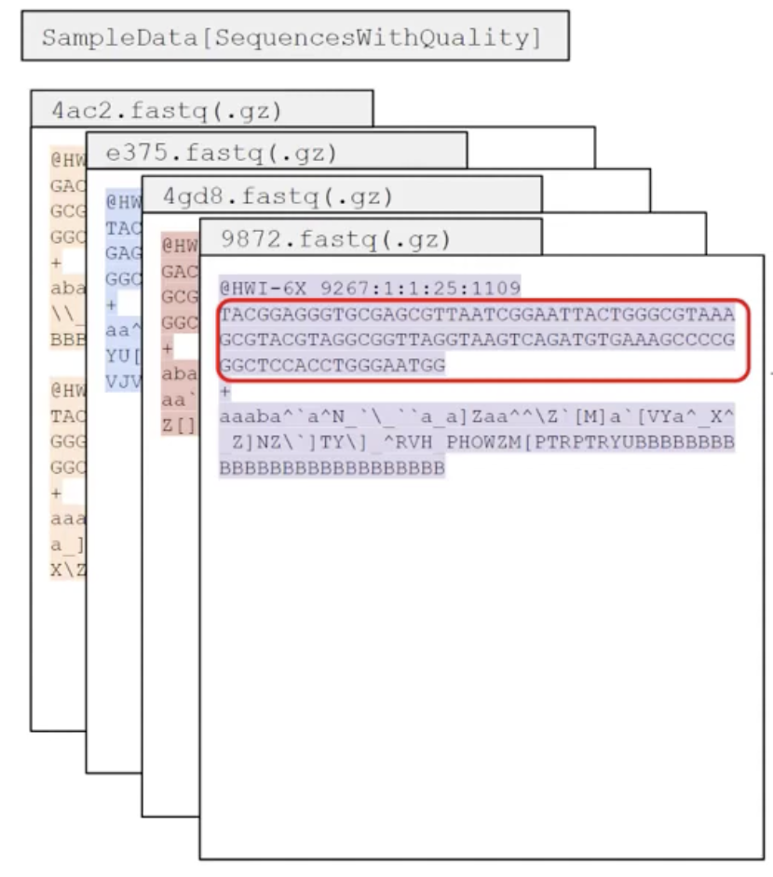
YOUTUBE-QIIME2

Slide 15
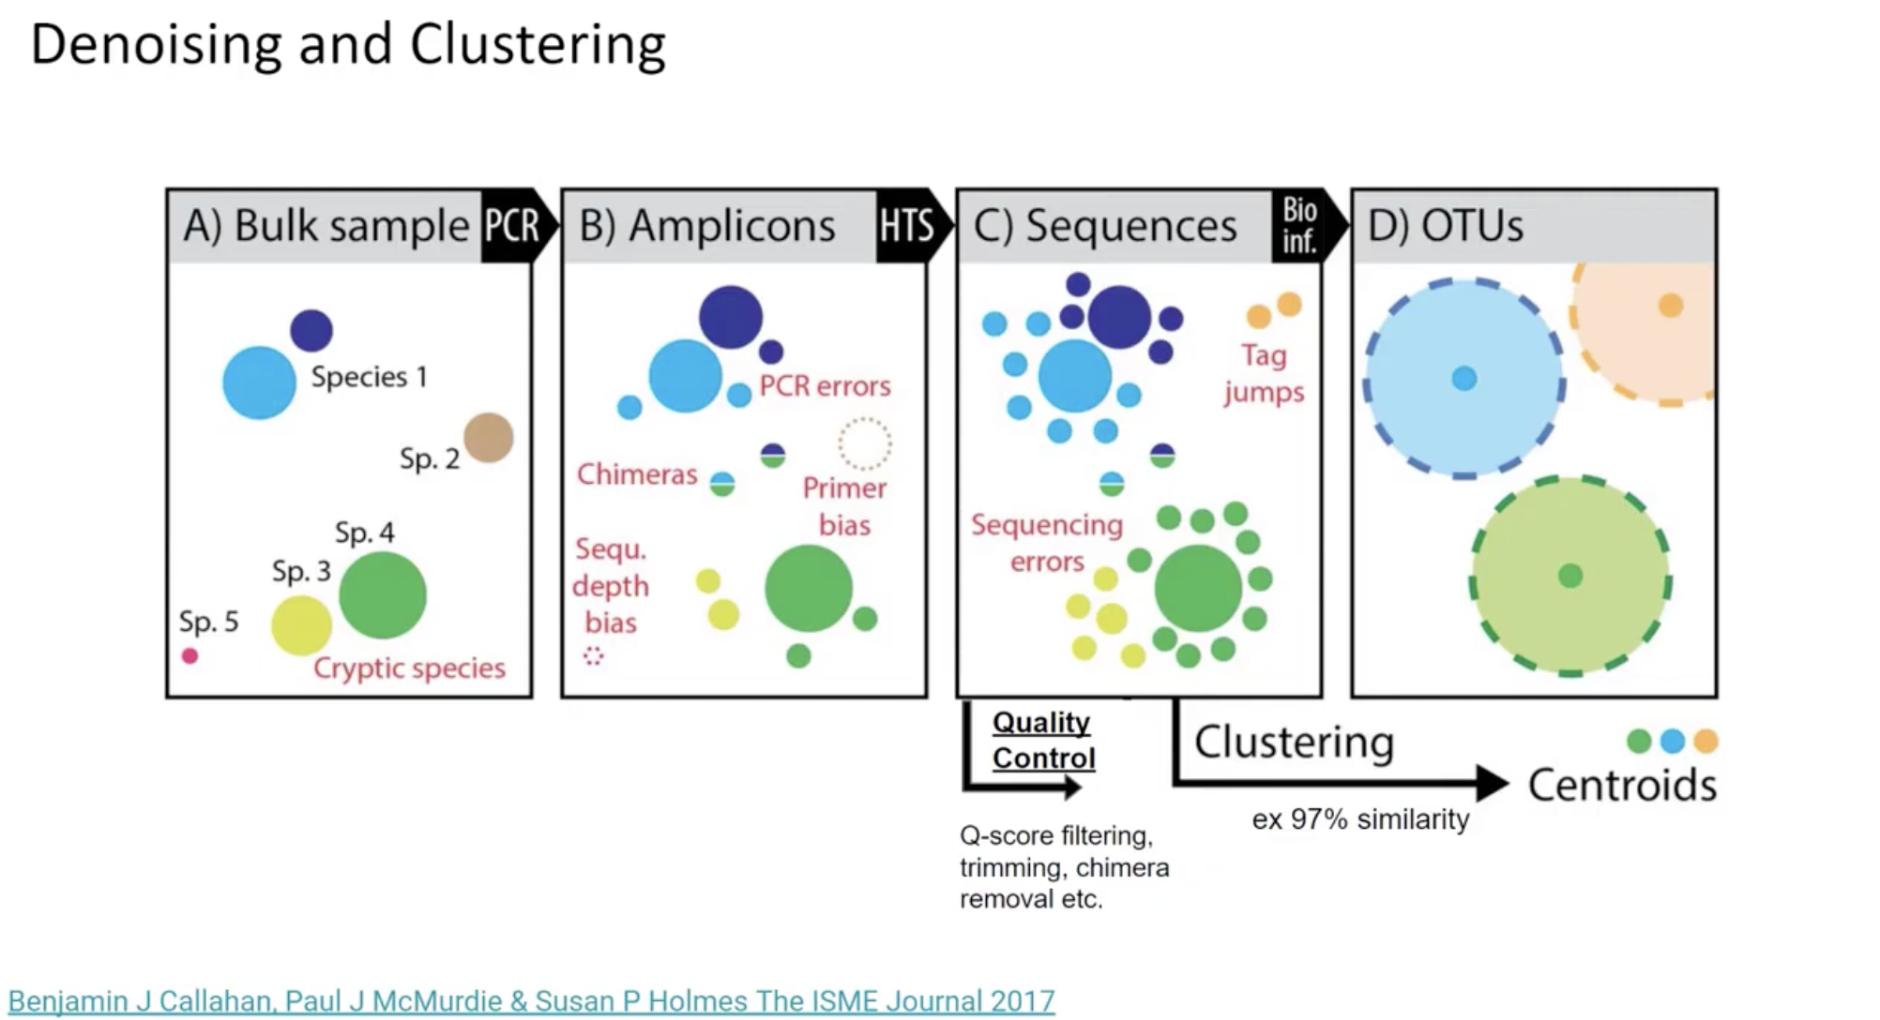
Notes:
Pcr errors during pcr by polymerase,
2 unrelated sequence combined-chimera
Missing species from original community-not enough depth or pcr material
Sequncing errors / contaminations
Best is not happening, but how do we deal with it in real world?
Quality control(Q-score filtering / trimming / chimera removal)
And clustering sequences with similarity(ex)97%)-numerous clustering algorithms

Slide 16
3. Reads should then be denoised or clustered to achieve two goals:
a) reducing sequence errors
b) dereplicating sequences
To be more descriptive,
We denoise sequences to remove and/or correct noisy reads.
We dereplicate our sequences to reduce repetition and file size/memory requirements in downstream step.
We cluster sequences to collapse similar sequences (e.g., those that are ≥ 97% similar to each other) into single replicate sequences, also known as OTU picking.
Notes:
This process, also known as OTU picking, was once a common procedure, used to simultaneously dereplicate but also perform a sort of quick-and-dirty denoising procedure (to capture stochastic sequencing and PCR errors, which should be rare and similar to more abundant centroid sequences). Use denoising methods instead if you can. Times have changed. Welcome to the future.

Slide 17
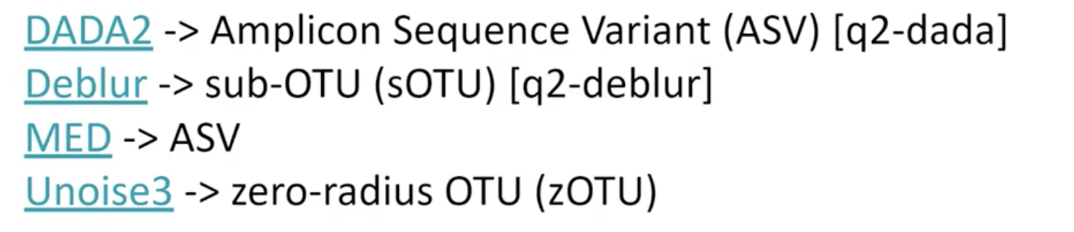
Denoise
Denoisers(denoising tools)
Each tool refering to.. →
Choosing right tool for right aim
In case of DADA2,
-> A software package(pipeline for detecting and correcting) that models and corrects Illumina-sequenced amplicon errors
DADA2 denoise(single) requires 2 parameters that are used in quality filtering:
--p-trim-left m : which trims off the first m bases of each sequence.
--p-trunc-len n : which truncates each sequence at position n.
→This allows to remove low quality regions of the sequences!

Slide 18
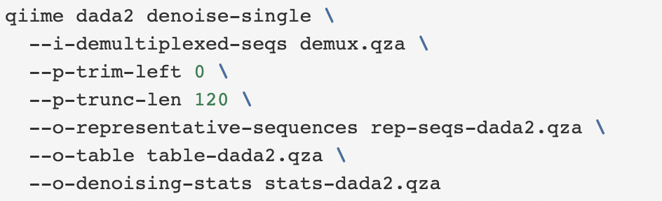
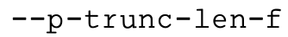
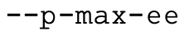
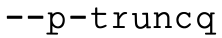
No trimming any bases from the beginning of the sequences.
→ In case the quality of the initial bases is high
The quality seems to drop off around position 120,
so truncating sequences at 120 bases.
will both merge and denoise paired-end reads(not case of single)
Indicates the position at which the forward sequence will be truncated.
In case of reverse, r instead of f.
Indicates the position at which the forward sequence will be truncated.
In case of reverse, r instead of f.
Truncates the sequence after the first position that has a quality score equal to or less than the provided value.

Slide 19
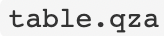
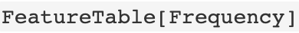
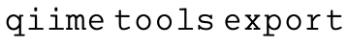
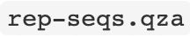
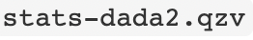
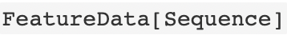
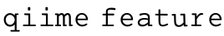
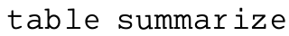
After denoising…
two artifacts drawn : a table file and a representative sequence file.
(And can be exported by , for use in other utilities)
2 of the most important artifacts in an amplicon sequencing workflow
Output visualizable by
Filter sequence table
After DADA2(or other denoising pipeline),
Many reads may have been excluded.
So, user may wish to exclude any samples that have significantly fewer sequences than the majority.
produces a visualization file that shows the spread of sequence depths across the samples
Feature?
→ Any unit of observation.
An OTU, a sequence variant, a gene, a metabolite…etc,
And a feature table is a matrix of sample-feature abundances
Notes:
excluded because they could not be merged or were rejected.

Slide 20
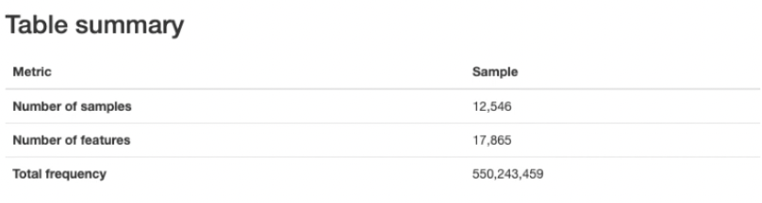
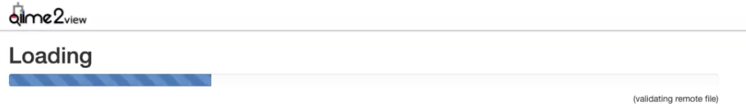
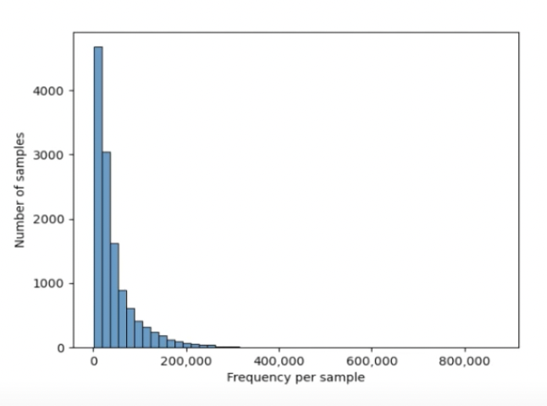
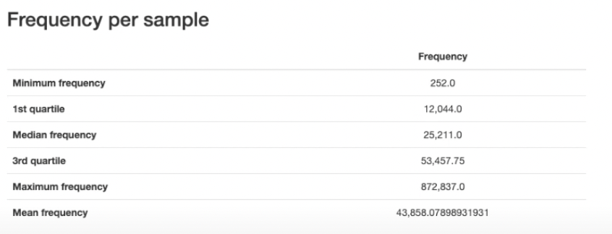
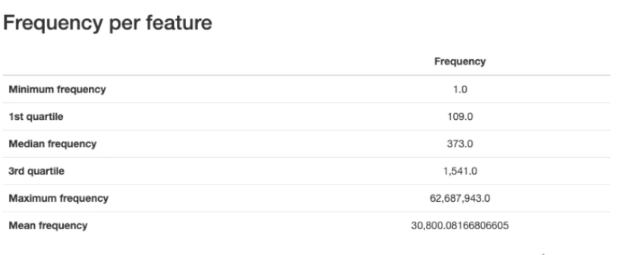
Total number of features
Sample which has the least features → has 252
X-axis : frequency of features per sample
YOUTUBE-QIIME2

Slide 21
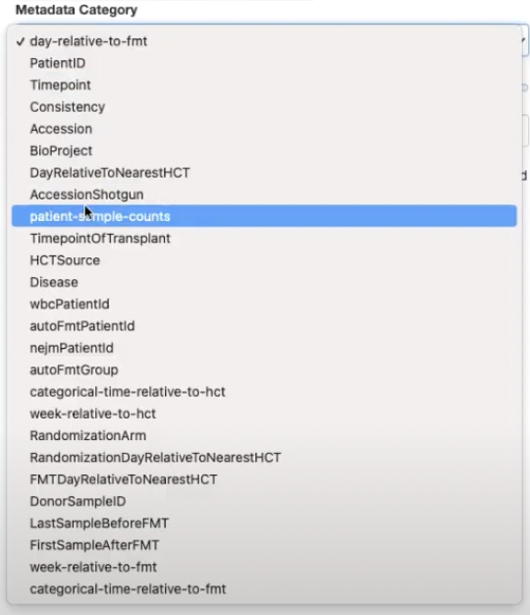
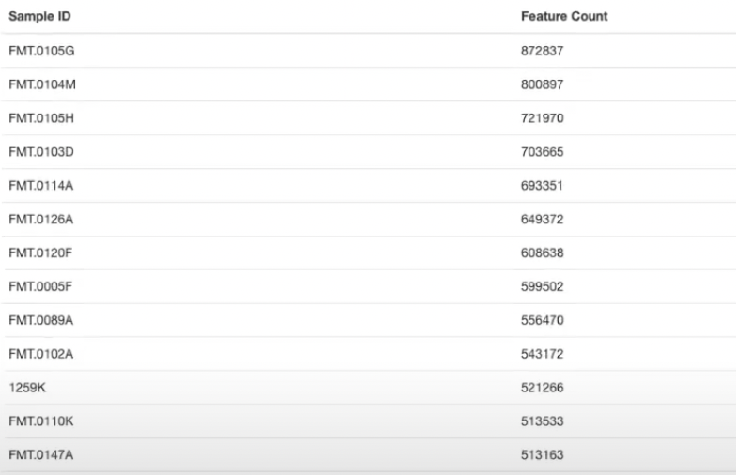
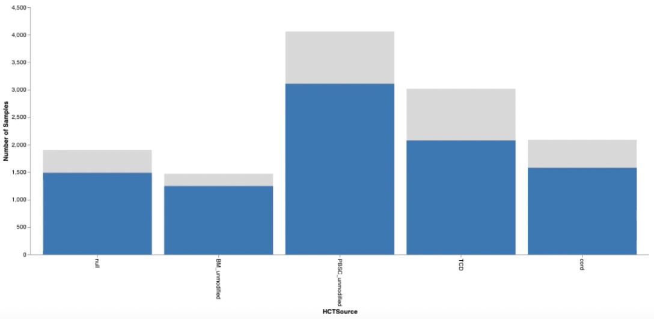
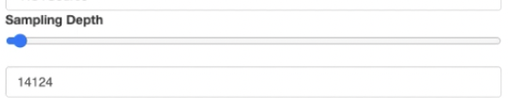
Counting features by each sample
Selecting metadata categories
Also able to control sample depth↑→
YOUTUBE-QIIME2

Slide 22
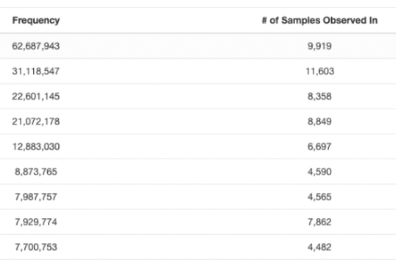
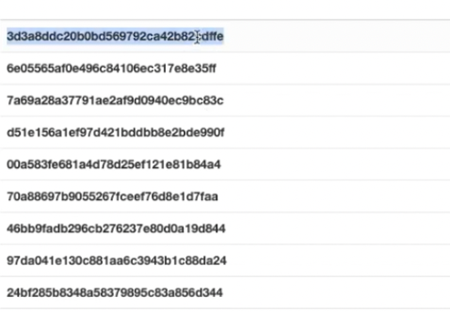
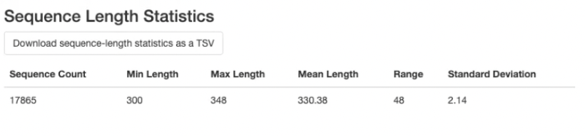
Feature detail
Feature
↑Can relate to actual asv sequence
And, generate summaries of full table and sequence data → rep-seqs.qzv
YOUTUBE-QIIME2

Slide 23




Earning a sequence for each feature
Not a hard task to match-up with other references

Slide 24

YOUTUBE-QIIME2

Slide 25






What genera or species are present in my samples?
Find out by comparing earned sequences (features…ASVs/OTUs) to a reference database of sequences with known taxonomic composition
Taxonomy classifiers
Used to determine the closest taxonomic affiliation with consensus based on alignment, k-mer frequencies…etc
take reference database from
Alignment-based methods
Files directly
Machine-learning-based classification method
Trained to learn which features best distinguish each taxonomic group
Machine learning Python library
Notes:
must be trained, e.g., to learn which features best distinguish each taxonomic group

Slide 26

Taxonomical classification
Workflow…

Slide 27
In case of general classify-sklearn method,
Naive Bayes classifier slightly outperform other methods for classification of 16S rRNA gene and fungal ITS sequences.
Feature classification can be slow.
→ Depends on the number of sequences you have, and the number of reference sequences.
Varies from few minutes to several hours.
Feature classification can be memory intensive.
→ Usually minimum 4 GB, maximum 32+ GB required.
Depends on the size of the reference sequences, length, and number of query sequences
Notes:
in general classify-sklearn with a Naive Bayes classifier can slightly outperform other methods we’ve tested based on several criteria for classification of 16S rRNA gene and fungal ITS sequences

Slide 28



Importing Naïve bayes classifier from wget
Make a training & run to query sequence data files – rep-seqs.qza
Generate a visualization of the resulting mapping to taxonomy
Training my own classifier is also possible!
→ Classifiers perform best when trained based on your specific sample preparation and sequencing parameters.
Including the primers that were used for amplification and the length of sequence reads.
Notes:
The first step in this process is to assign taxonomy to the sequences in our FeatureData[Sequence] QIIME 2 artifact. We’ll do that using a pre-trained Naive Bayes classifier and the q2-feature-classifier plugin. This classifier was trained on the Greengenes 13_8 99% OTUs, where the sequences have been trimmed to only include 250 bases from the region of the 16S that was sequenced in this analysis (the V4 region, bound by the 515F/806R primer pair). We’ll apply this classifier to our sequences, and we can generate a visualization of the resulting mapping from sequence to taxonomy.

Slide 29



Taxonomy classifiers & Phylogeny bulid
The taxonomic profiles of each sample can be visualized by

